Slide 1
COMS30043 Games Project
Technical Introduction and Tutorial
Jordan Taylor

Slide 2
Preamble
Sections shall be broken up into what is deemed Essential, Conditional, and Suggested knowledge.
Figures, images, and diagrams are derived from the source code of the following projects:
Insane Ian (UoB 2021 Games Project)
Commodore Mandeville: Revenge of The Martians
Space Quest: 2099
They Came First
Rights to the projects and their assets are wholly owned by Jordan Taylor and may be distributed freely for educational purposes. Links in references.

Slide 3










Slide 4

About Unity
Unity is a cross-platform game engine initially released in 2005.
Unity is general purpose – able to facilitate the creation of 2D and 3D games, simulations, as well as interactive content.
Unity now supports over 20 different target platforms for deploying, so the chances are you’ll be able to deploy to any platform you’ve brainstormed up!

Slide 5
In This Session:
Essential
Basics of the Unity Engine
Installing Unity
Compatible IDEs
Project settings and environment set-up
Navigation within the editor
GameObjects
Transforms and GameObject Parenting
Component oriented framework
The Camera
Building Your Game

Slide 6
In This Session:
Essential
Interactions within the Unity Engine.
Physics and Rigidbodies
Collisions
Scripting
Prefabs and GameObject Instantiation
Scene Management
Packages and Imports

Slide 7
In This Session:
Essential
Implementation within the Unity Engine.
C# and OOP within Unity
Coroutines
Addressing components in code
The Console
Performance Profiler
Creating User Interfaces

Slide 8
In This Session:
Essential
Effects within the Unity Engine.
Lighting
The Particle System
Audio Sources and Audio Listeners
Sprites
Shaders

Slide 9
In This Session:
Conditional
Advanced Effects within the Unity Engine.
Post Processing
Ambient Occlusion
Global Illumination
Culling Masks and Layers

Slide 10
In This Session:
Conditional
Networking within the Unity Engine.
Network architectures
PUN (Photon Unity Networking)
Serialisation
RPCs (Remote Procedure Calls)

Slide 11
In This Session:
Conditional
VR and Peripherals within the Unity Engine.
HTC Vive
Control
Occulus

Slide 12
In This Session:
Suggested
Workflow Suggestions within the Unity Engine.
Import workflow
Git Usage
Gitkracken
Kanban Boards

Slide 13
In This Session:
Suggested
Package and Technology Suggestions within the Unity Engine.
Cinemachine
Mechanim
New Input System Package
Universal Render Pipeline

Slide 14
Basics of the Unity Engine
Essential
Section I

Slide 15

1 – 1: Installing Unity
Essential
Head to unity.com/download

Slide 16
1 – 1: Installing Unity
Essential
Head to unity.com/download
Download the Unity Hub (This lets you manage multiple Unity installations)

Slide 17
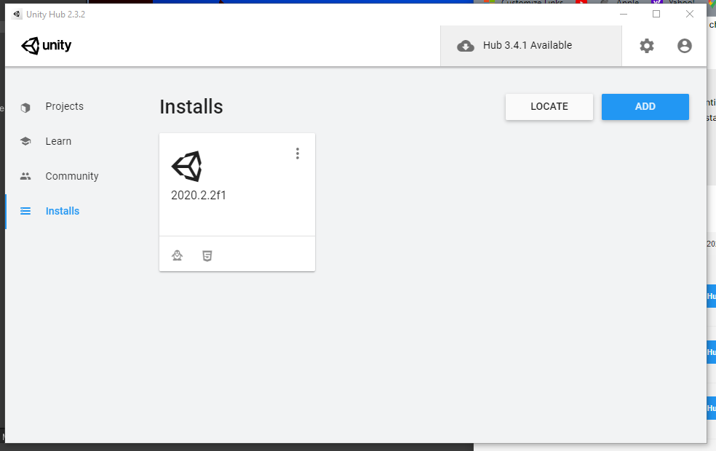
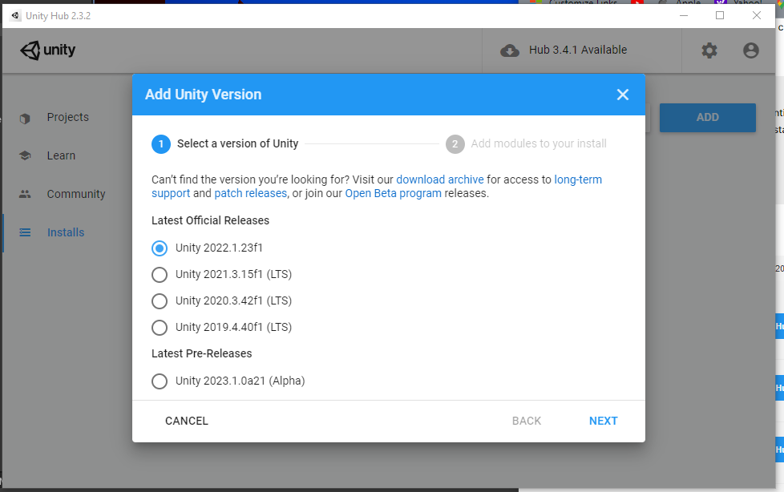
1 – 1: Installing Unity
Essential
Head to unity.com/download
Download the Unity Hub (This lets you manage multiple Unity installations)
Add the most recent stable build of Unity (it is recommended to avoid beta or alpha builds). As of January 2023, this is Unity 2022.1.23f1. Ensure all team members install the same version of Unity!

Slide 18
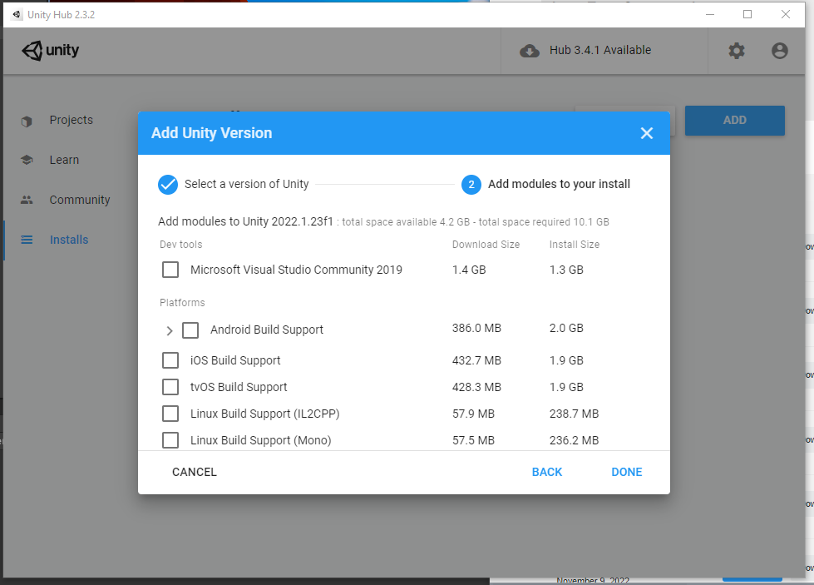
1 – 1: Installing Unity
Essential
Head to unity.com/download
Download the Unity Hub (This lets you manage multiple Unity installations)
Add the most recent stable build of Unity (it is recommended to avoid beta or alpha builds). As of January 2023, this is Unity 2022.1.23f1. Ensure all team members install the same version of Unity!
Select relevant modules to add to your Unity installation. Windows, Mac, Linux, and WebGL build support are recommended.

Slide 19
1 – 1: Installing Unity
Essential
Head to unity.com/download
Download the Unity Hub (This lets you manage multiple Unity installations)
Add the most recent stable build of Unity (it is recommended to avoid beta or alpha builds). As of January 2023, this is Unity 2022.1.23f1. Ensure all team members install the same version of Unity!
Select relevant modules to add to your Unity installation. Windows, Mac, Linux, and WebGL build support are recommended.

Slide 20




1 – 2: Compatible IDEs
Essential
Unity doesn’t play nice with all IDEs. Unity directly supports the following IDEs:
Visual Studio Professional/Community
Visual Studio Code
Jetbrains Rider

Slide 21

1 – 2: Compatible IDEs
Essential
When you install Unity on Windows and macOS, by default Unity also installs Visual Studio. You can choose to exclude it when you select which modules to download and install.
Visual Studio, despite not being a particularly lightweight application, tends to work rather well ‘out the box’, managing required Unity dependencies and packages automatically.

Slide 22
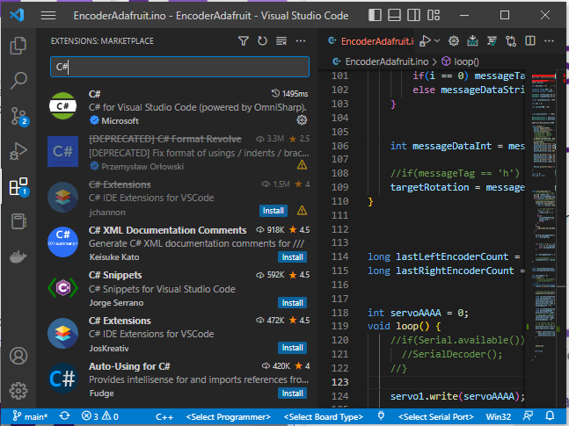
1 – 2: Compatible IDEs
Essential
To use Visual Studio Code for C# code editing and Unity C# debugging support, you need to install:
Mono (only required on macOS and Linux)
Visual Studio Code C# Extension
Visual Studio Code Debugger for Unity Extension
Personally, this is my favourite IDE to use.

Slide 23

1 – 2: Compatible IDEs
Essential
JetBrains Rider has functionality on Windows, MacOS, and Linux.
Rider is based on ReSharper and includes most of its features. It supports all of C# 7.2’s features as well as C# debugging on the .NET 4.6 scripting runtime in Unity.
As such, similar to Visual Studio, it tends to work well out the box.
Despite this, Rider may ask that you register for an educational license or a trial period.

Slide 24
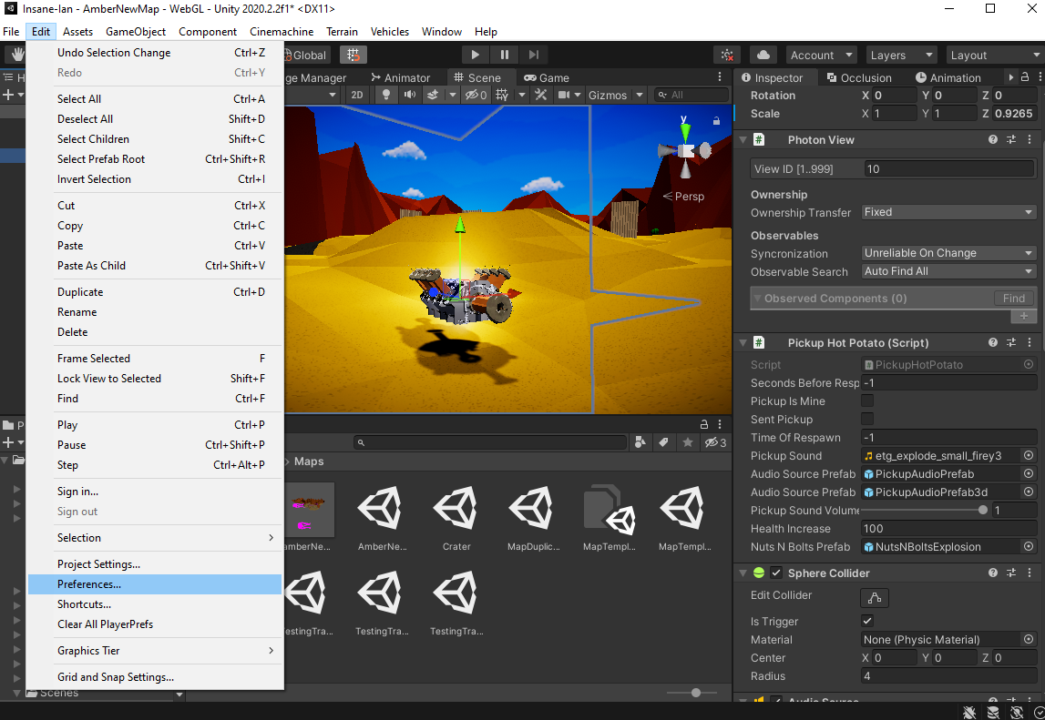
1 – 3: Preferences
Essential
The preferences window allows you to define how you want the Unity editor to behave. These settings are not shared through version control.
To open the Preferences window, go to Edit > Preferences.

Slide 25
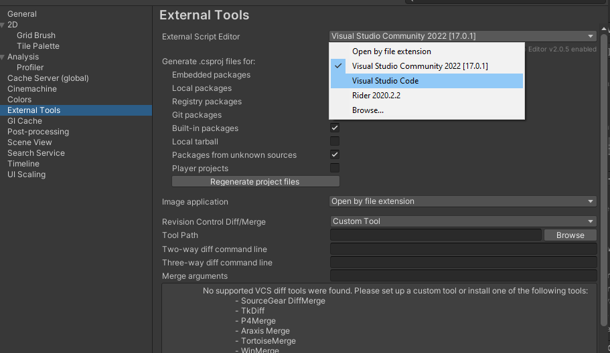
1 – 3: Preferences
Essential
From the preferences window, you are able to perform tasks such as:
Select an external script editor (IDE)
Setting Unity’s colour scheme
Managing the Global Illumination Cache
UI scaling and Accessibility

Slide 26
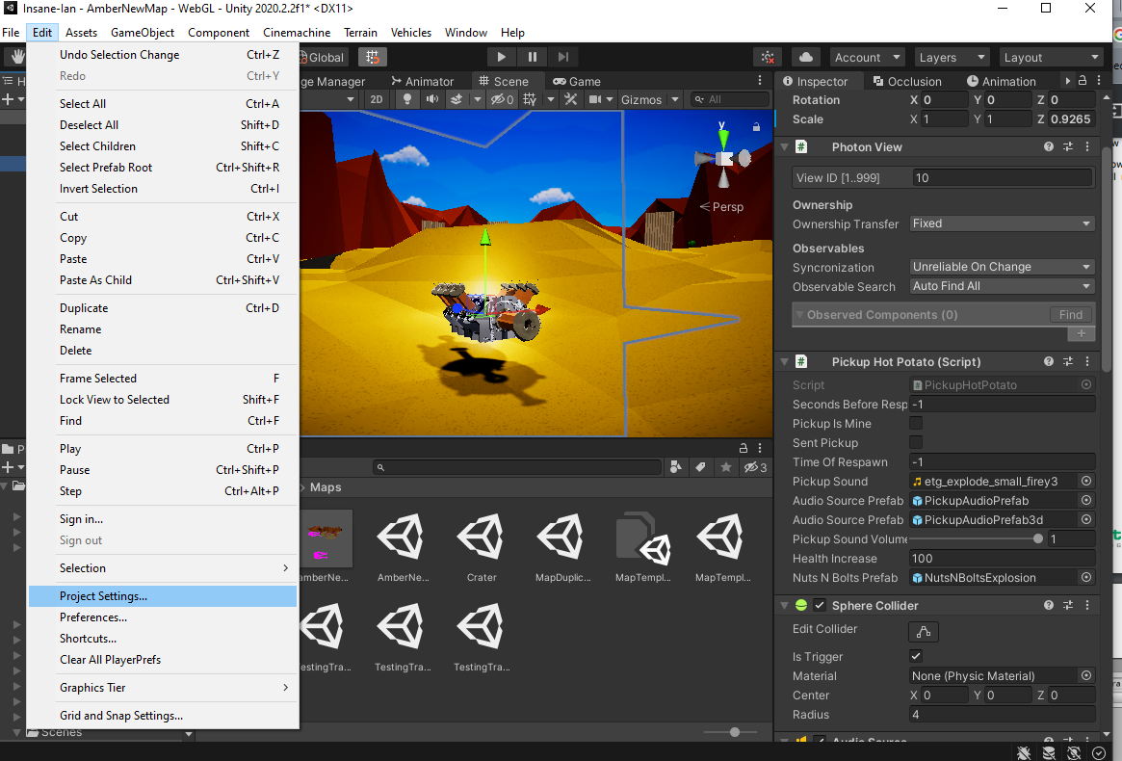
1 – 4: Project Settings
Essential
You may define settings for your project using the Project Settings window.
These settings may be shared with other team members by your version control software, so be mindful!
To open the Project Settings window, go to Edit > Project Settings.

Slide 27
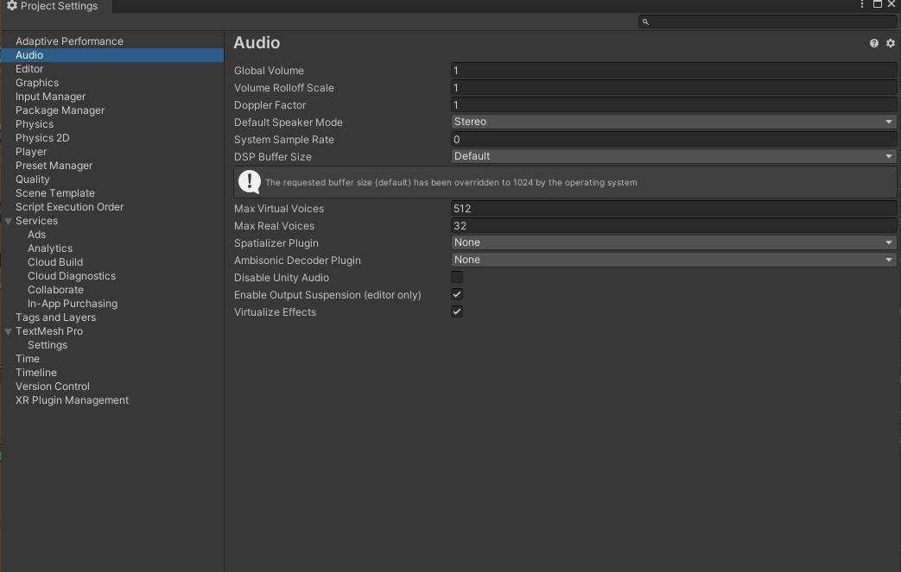
1 – 4: Project Settings
Essential
The Project Settings Window includes controls for:
Adaptive performance
Audio
Graphics and Quality Presets
Physics conditions
Time and game update rates
Input Management (Legacy)
“Player” settings

Slide 28
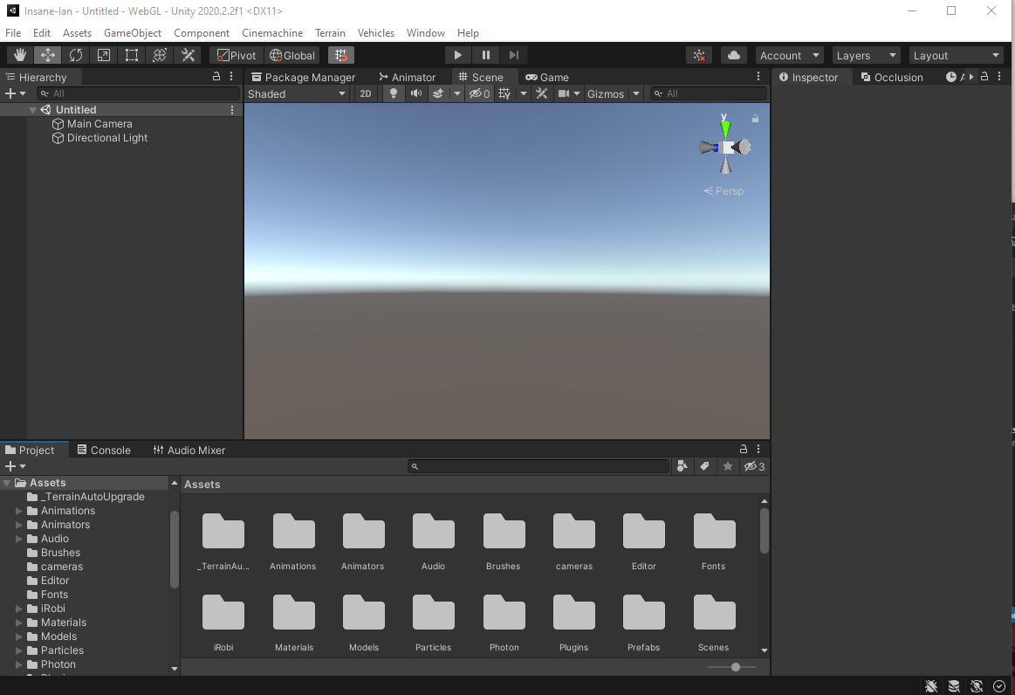
1 – 4: Navigating The Editor
Essential
Upon creating a new project, a screen similar to below should appear:

Slide 29
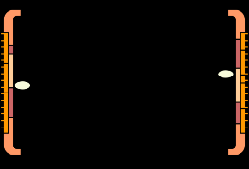

1 – 4: Navigating The Editor
Essential
The highlighted area is called the Scene view. Scenes are analogous to levels – in which all of your game takes place.
It is a 3D space in which your GameObjects are interactable.
GameObjects can be anything from the player’s model to the GUI on the screen, from buttons and enemies to invisible “managers” like sources of sound.
You will be able to drag and position prefabs from the Project view into the Scene view.

Slide 30

1 – 4: Navigating The Editor
Essential
The region on the left is the Scene Hierarchy. It is where all currently existing GameObjects are listed with respect to their parent-child transform relationship, each belonging to and being listed under a scene name.
In our case, that is presently untitled.
Presently, the only GameObjects that can be seen are the Main Camera and a Directional Light

Slide 31
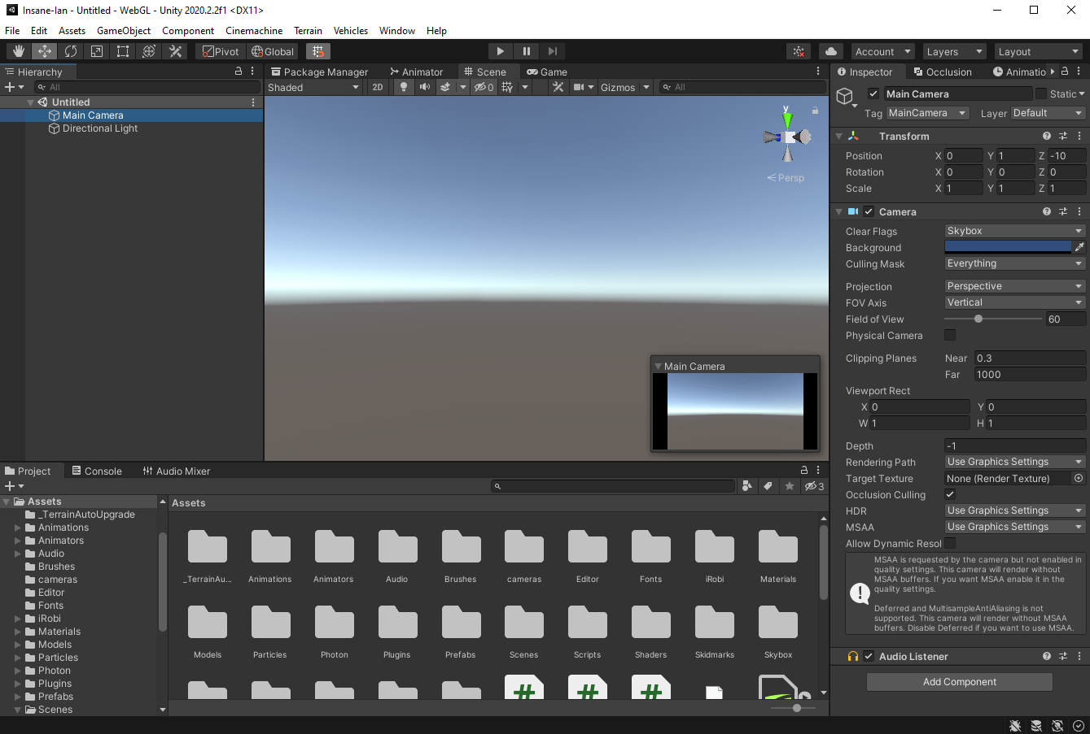


1 – 4: Navigating The Editor
Essential
The region on the right is the Inspector. If we click on the Main Camera GameObject in the Hierarchy, the inspector becomes populated.
Here we can view and edit the name of the GameObject, as well as the Transform, Camera, and Audio Listener Components.
We are also able to add new components.

Slide 32

1 – 4: Navigating The Editor
Essential
You may explore your project directory using the highlighted Project window, normally located below the scene view and hierarchy.
The majority of your project files will be made up of scripts, prefabs, materials and textures.
The example shows Insane Ian Project files.

Slide 33
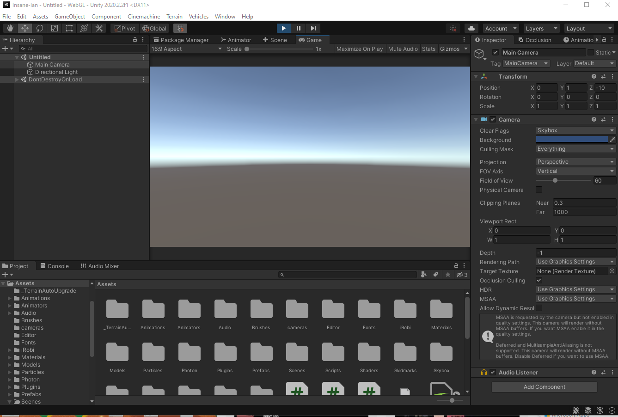
1 – 4: Navigating The Editor
Essential
Selecting the Game window tab and pressing the play button will play an interpreted version of your scene in its current state.
There are no visible objects in the scene, so the Main Camera simply renders the skybox at the horizon.
In this case, the Game view has replaced the Scene view – but this does not have to be the case! All windows can be dragged around and rearranged – even to separate monitors!

Slide 34
1 – 5: GameObjects
Essential
As mentioned before, a scene is made out of objects, called GameObjects.
GameObjects follow a similar paradigm to Objects in OOP (don’t get confused, objects still exist, we’re not describing code yet!)
GameObjects are instantiations of a base prefab.
GameObjects have a set of components attached to them, which describe how they behave in the scene, as well as how they react to others in the scene.
Everything that exists in your game is a GameObject, and most of your scripting will be writing Monobehaviour components to define their behaviour and interactions.

Slide 35
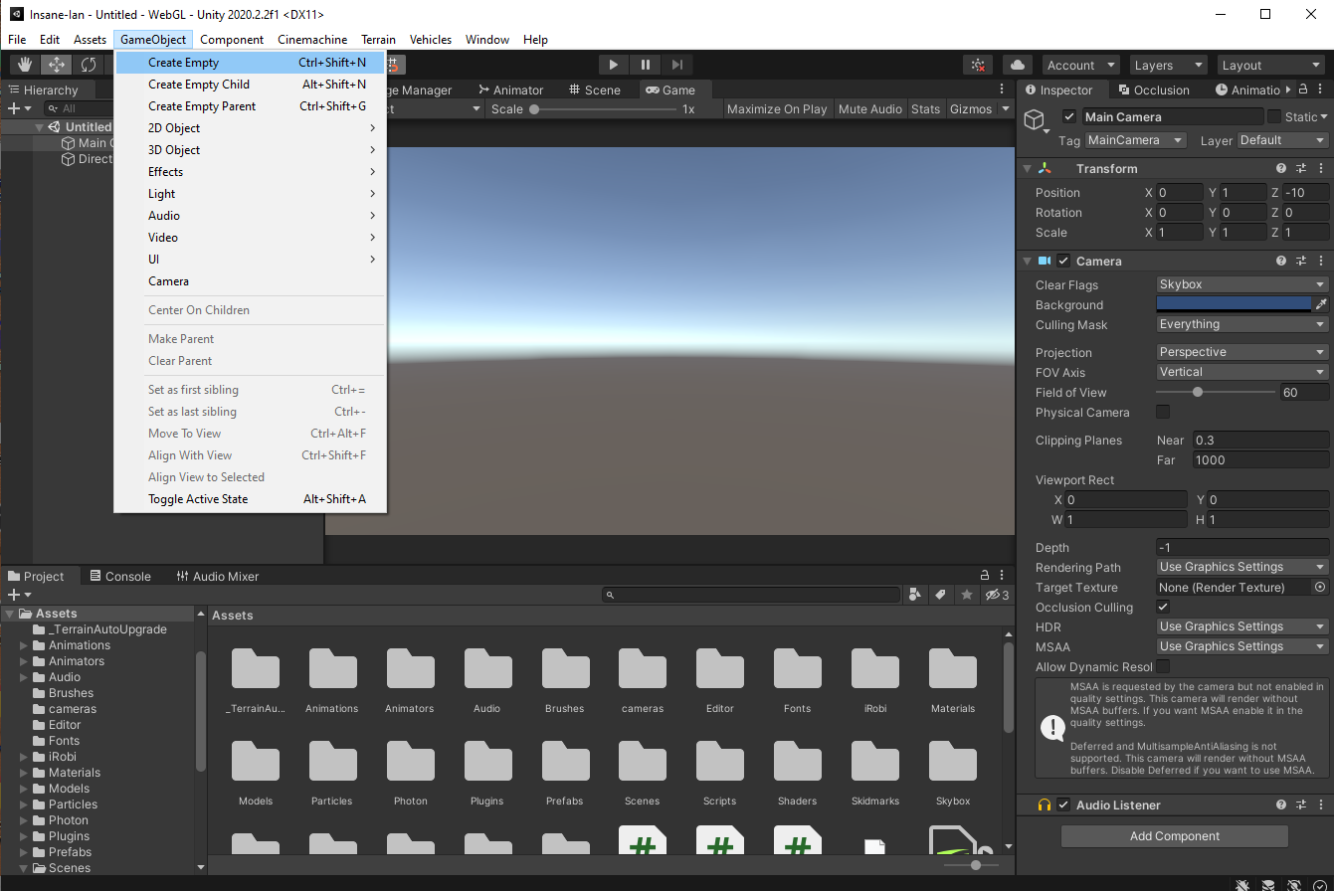
1 – 5: GameObjects
Essential
We can create a new empty GameObject in our Scene View by going to the GameObject tab and selecting ‘Create Empty’.
An empty GameObject exists without any components aside from a Transform, it is simply an entity within the scene.

Slide 36
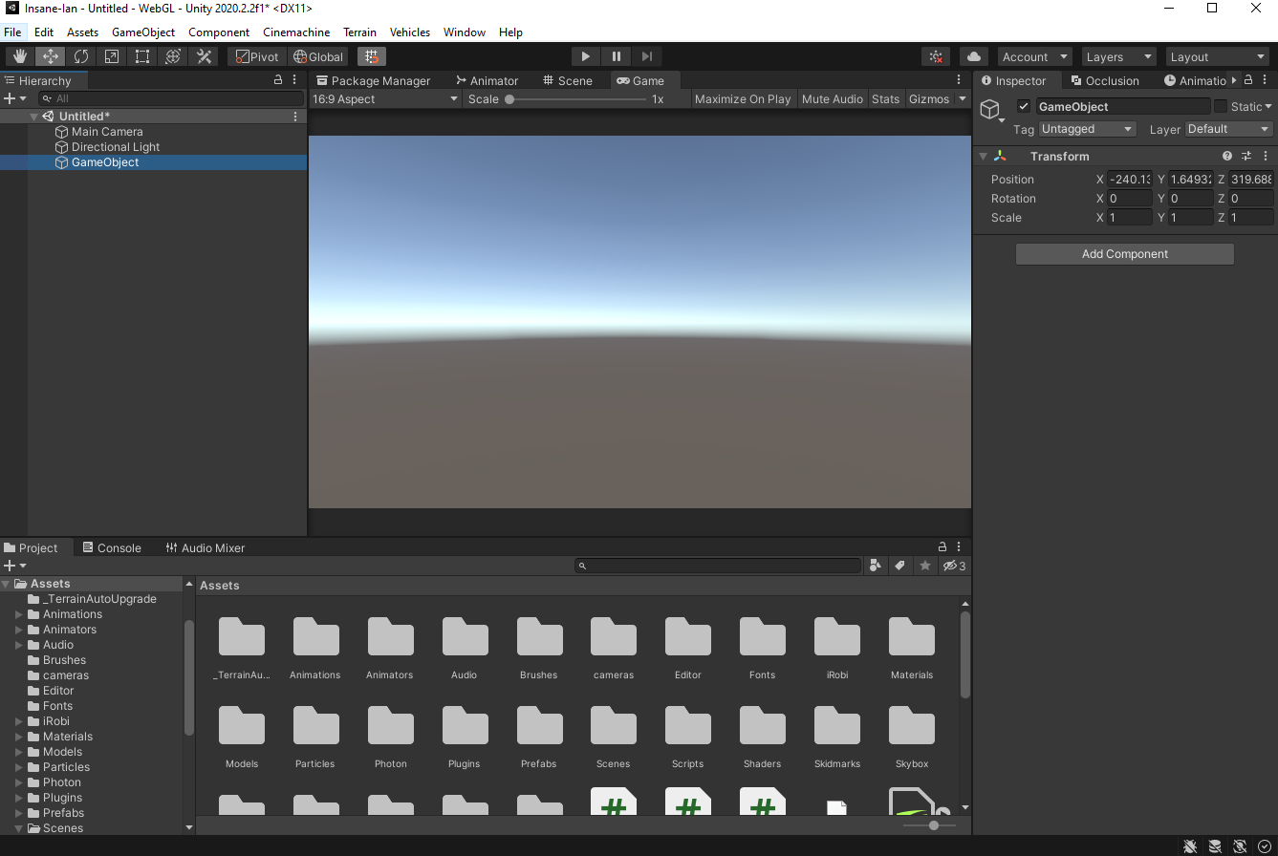
1 – 5: GameObjects
Essential
We can create a new empty GameObject in our Scene View by going to the GameObject tab and selecting ‘Create Empty’.
An empty GameObject exists without any components aside from a Transform, it is simply an entity within the scene.
Here’s an example of an empty GameObject.

Slide 37
1 – 5: GameObjects
Essential
GameObjects may be disabled in-editor or programmatically at runtime.
In editor, this is done with the highlighted checkbox.
This disables the behaviour of almost all components without destroying it.
Note that this does not affect the Awake() method.

Slide 38
1 – 5: GameObjects
Essential
You may Destroy a GameObject programmatically by calling the static Destroy method.
You may destroy a GameObject in-editor by pressing delete.

Slide 39

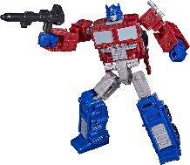
1 – 6: Transforms and Parents
Essential
All GameObjects must have a Transform component.
Transform governs the GameObject’s position, rotation, and scale with respect to its current frame of reference (local or global space).
Rotations are viewed as Euler Angles (x,y,z), but are internally represented as Quaternions.
It is generally recommended that you don’t try and write/set Quaternions yourself, and instead rely on wrapper methods.

Slide 40


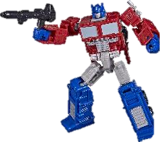
1 – 6: Transforms and Parents
Essential
We are able to ‘parent’ GameObjects to each other.
This can be done in the Hierarchy view, or programmatically at runtime.
A child transform will define itself in the local space of its parent, rather than in world space.
This means that it moves, rotates, and scales as if it were a part of the parent.

Slide 41
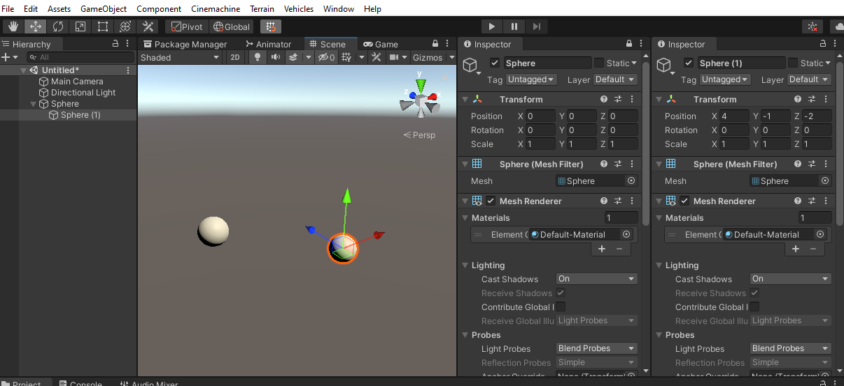
1 – 6: Transforms and Parents
Essential
Notes:
We are able to ‘parent’ GameObjects to each other.
This can be done in the Hierarchy view, or programmatically at runtime.
A child transform will define itself in the local space of its parent, rather than in world space.
This means that it moves, rotates, and scales as if it were a part of the parent.

Slide 42
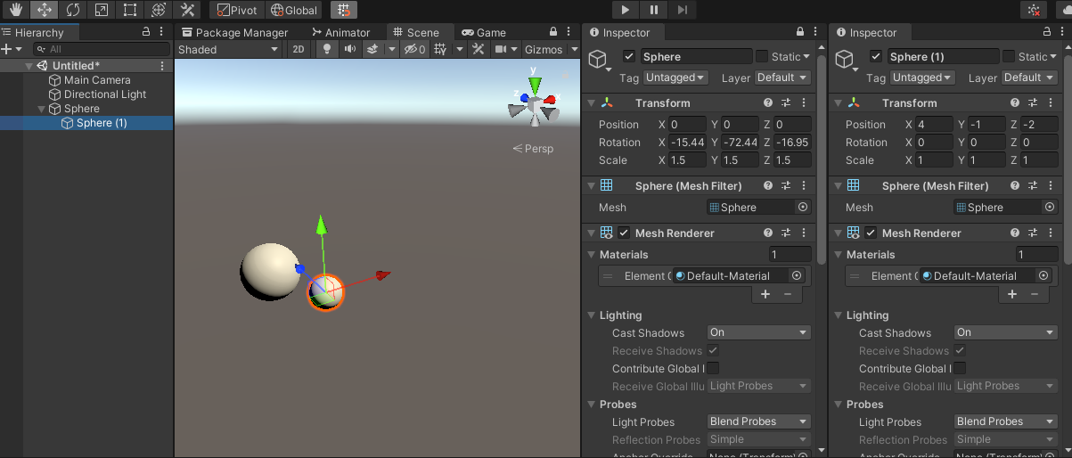
1 – 6: Transforms and Parents
Essential
Notes:
We are able to ‘parent’ GameObjects to each other.
This can be done in the Hierarchy view, or programmatically at runtime.
A child transform will define itself in the local space of its parent, rather than in world space.
This means that it moves, rotates, and scales as if it were a part of the parent.

Slide 43
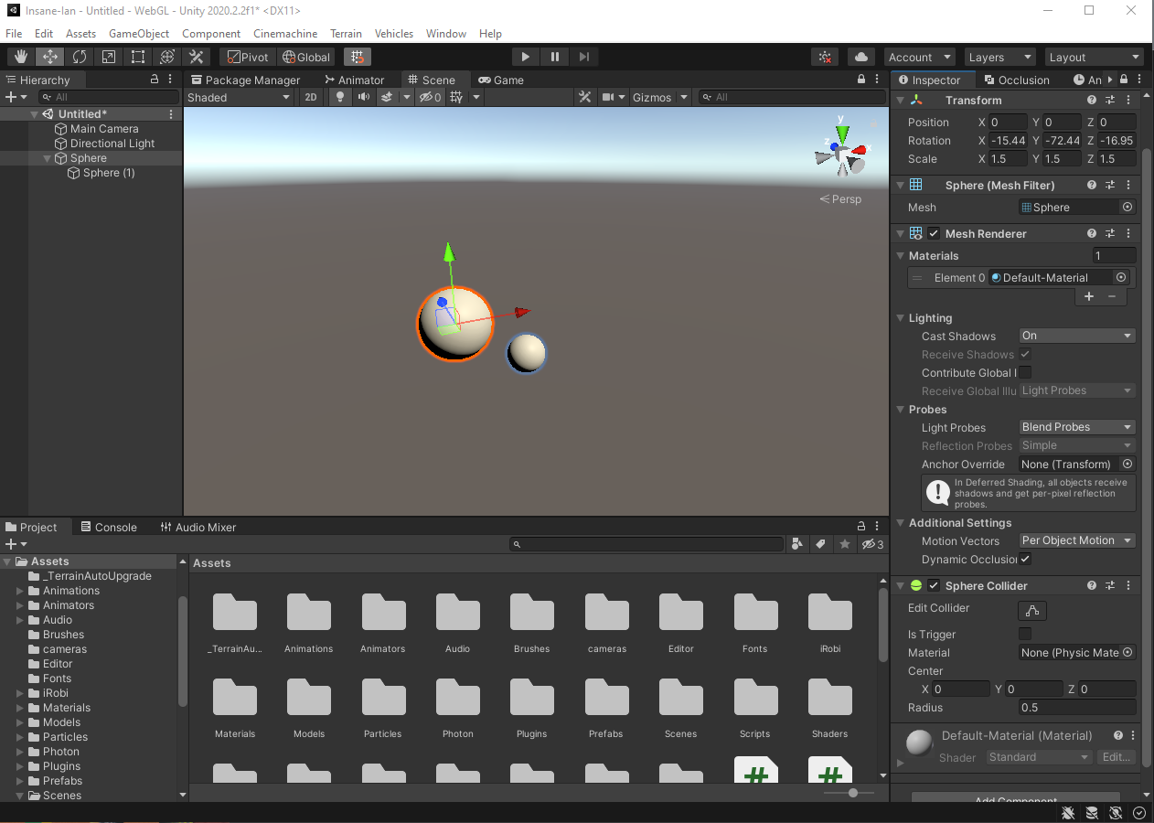
1 – 7: Components
Essential
Let’s take a look at our sphere GameObject.
We can see that it has a Transform, Mesh Renderer, Mesh Filter, and Sphere Collider (as well as subcomponent Material belonging to Mesh Renderer).

Slide 44
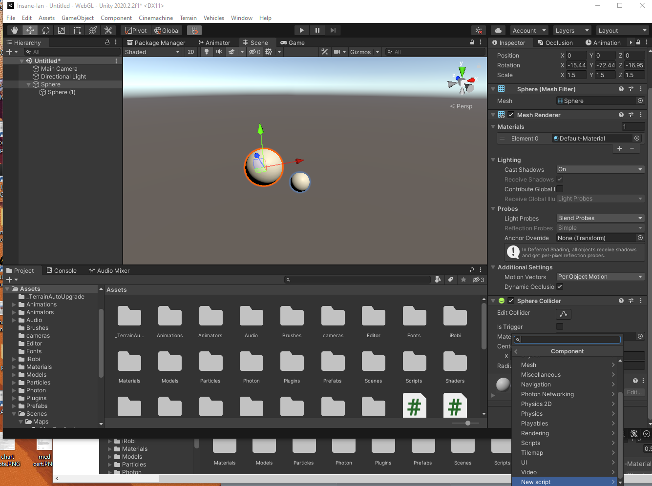
1 – 7: Components
Essential
Let’s take a look at our sphere GameObject.
We can see that it has a Transform, Mesh Renderer, Mesh Filter, and Sphere Collider (as well as subcomponent Material belonging to Mesh Renderer).
We can add more components, including our own defined Monobehaviours.

Slide 45
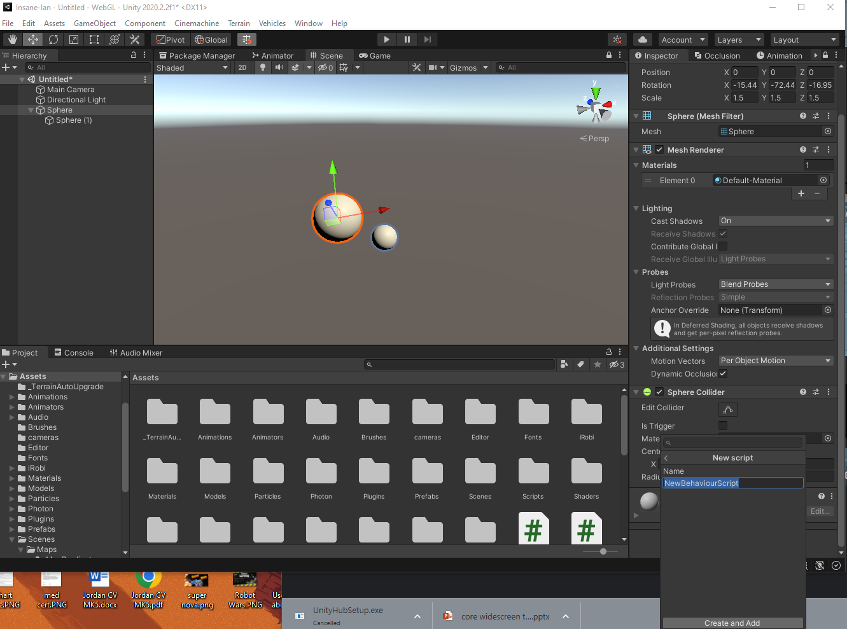
1 – 7: Components
Essential
Let’s take a look at our sphere GameObject.
We can see that it has a Transform, Mesh Renderer, Mesh Filter, and Sphere Collider (as well as subcomponent Material belonging to Mesh Renderer).
We can add more components, including our own defined Monobehaviours.

Slide 46
1 – 7: Components
Essential
Note that we can also drag scripts from the project view

Slide 47
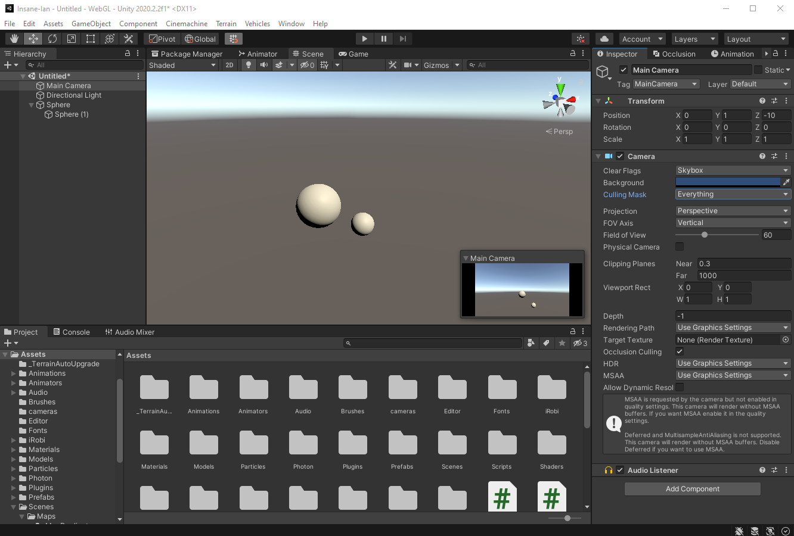
1 – 8: Camera
Essential
The Camera is the view through which you are able to view the Game World.
By default this is the Main Camera (with Tag Main Camera), with a culling mask over all layers. This means that the camera can view everything.
It is possible to switch between cameras by disabling the camera component on all other camera instances at runtime.

Slide 48
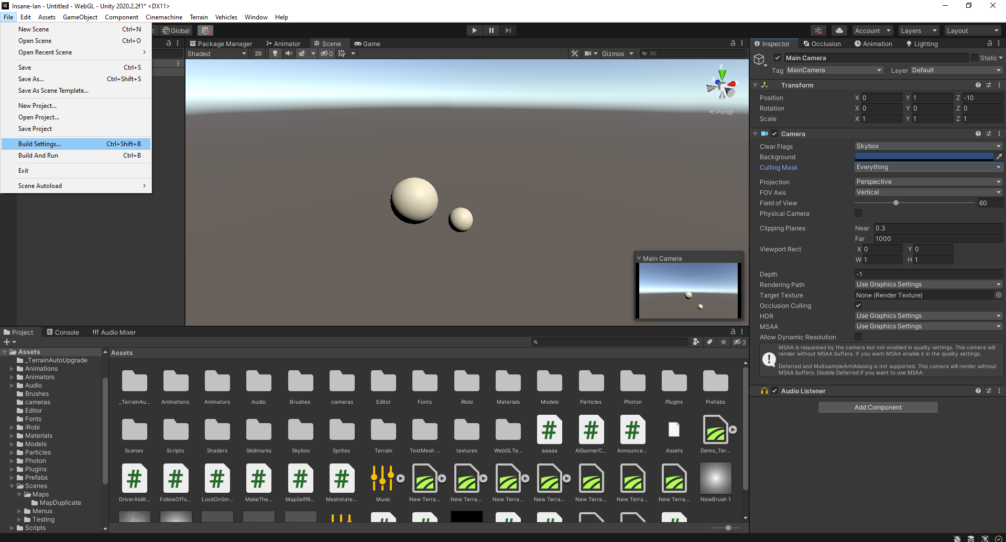
1 – 9: Building Your Game
Essential
To build your game means to compile and export it standalone to a target platform.
You’ll need to do this, Tilo won’t be very happy if you can only run your game in-editor.
Navigate to File -> Build Settings to begin the process

Slide 49
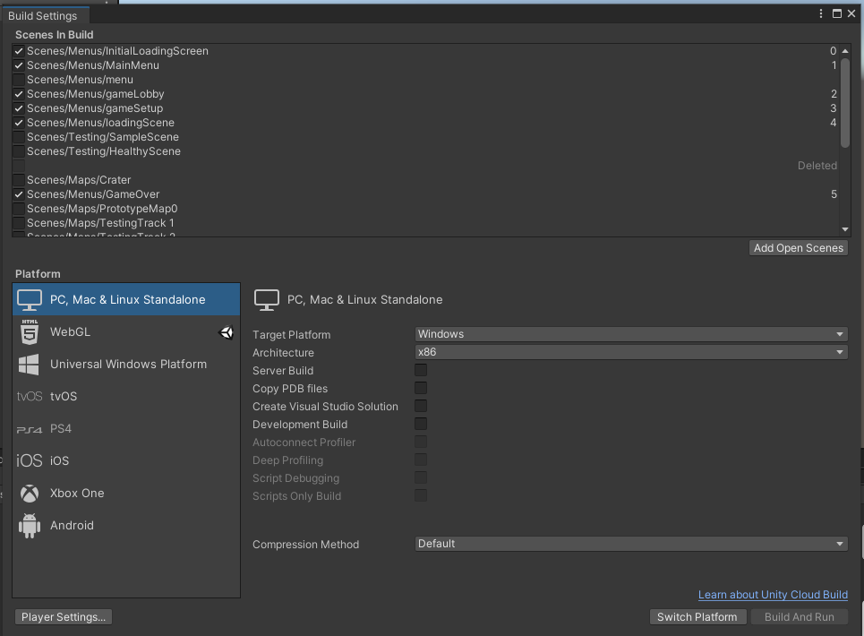
1 – 9: Building Your Game
Essential
In the build setting menu, you can see all the scenes currently in your game, determined from your project files.
Target platform may be chosen here, as well as architecture.
The little unity logo shows which platform your project is currently configured for.

Slide 50
Interactions within the Unity Engine
Essential
Section II

Slide 51
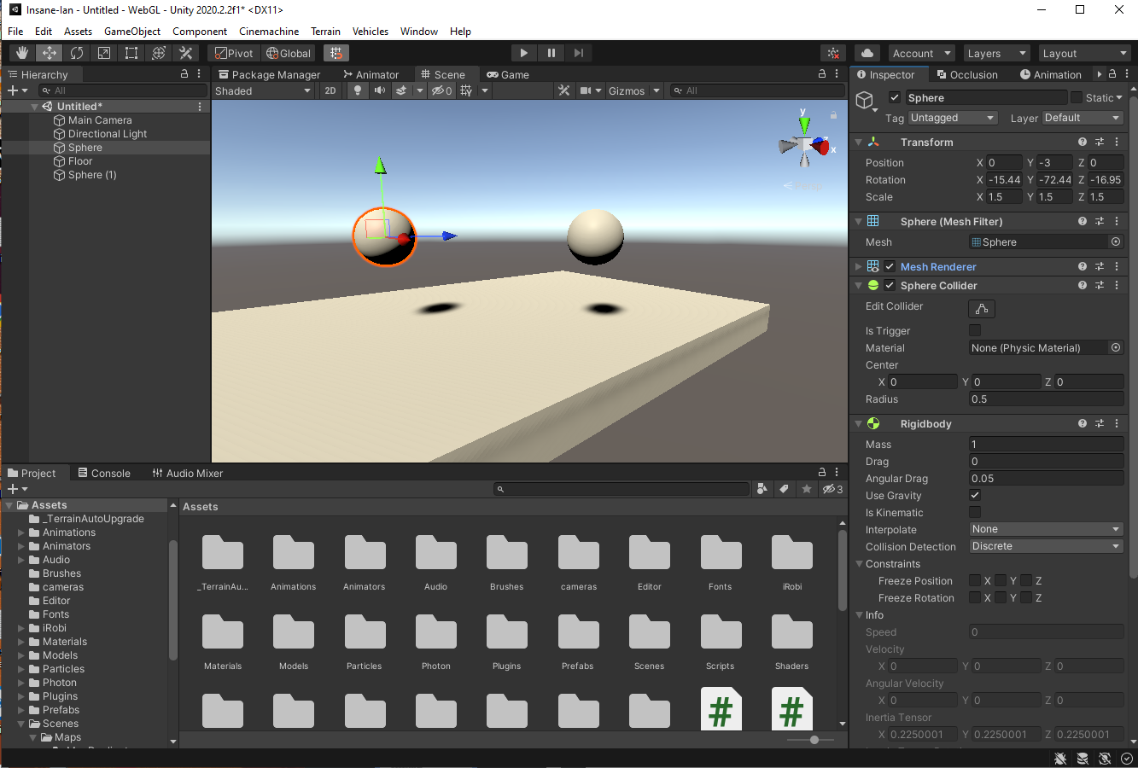
2 – 1: Understanding Collisions
Essential
When we consider every component as a GameObject, we realise that there could be thousands of GameObjects in a scene, interacting with each other in some way.
Computing every collision would introduce a huge amount of computational overhead.
Not all GameObjects need to be collidable!

Slide 52
2 – 1: Understanding Collisions
Essential
When we consider every component as a GameObject, we realise that there could be thousands of GameObjects in a scene, interacting with each other in some way.
Computing every collision would introduce a huge amount of computational overhead.
Not all GameObjects need to be collidable!
As such, collisions occur between Gameobjects with collider components, with one or more collision participants requiring a rigidbody.
Colliders come in multiple types, including Box, Sphere, and Mesh – all inheriting from the base Collider class.

Slide 53
2 – 2: Rigidbodies
Essential
Rigidbodies are components that allow a GameObject to react to real-time physics. This includes reactions to forces and gravity, mass, drag and momentum.
The Is Kinematic defines whether other rigidbodies are able to interact with its own physics.
The enumerated interpolate field pertains to how the object should behave with different physics timestep update rates.
There are two key game ticks in Unity:
Framerate and fixed update.

Slide 54
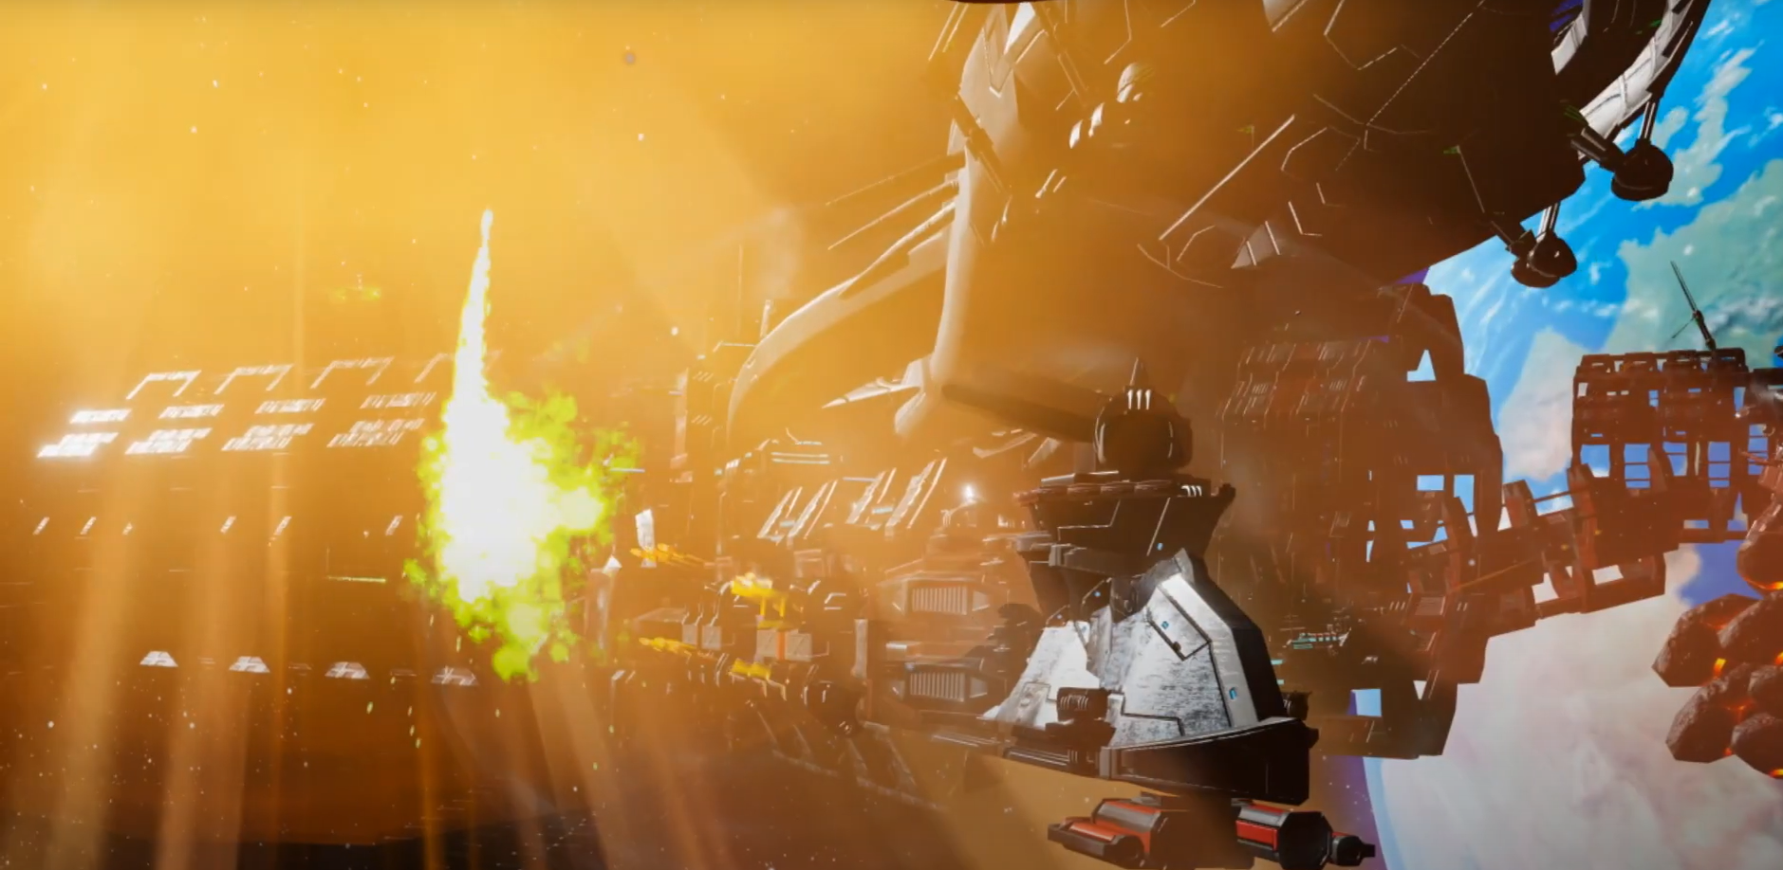
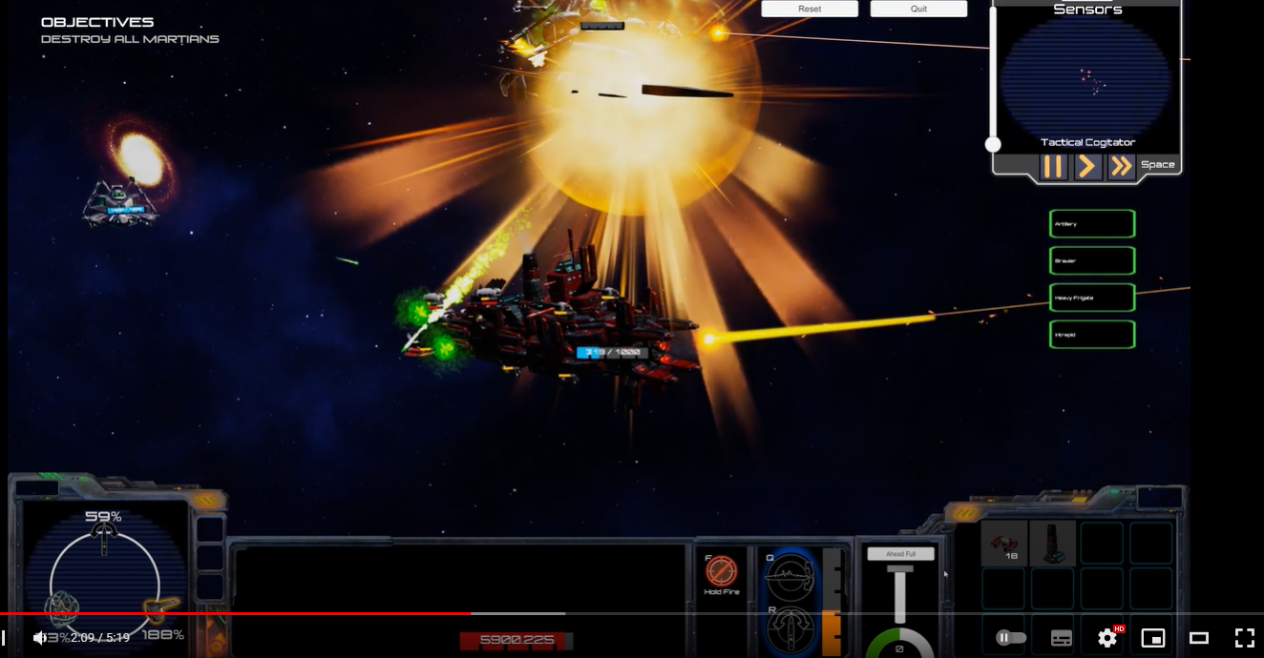
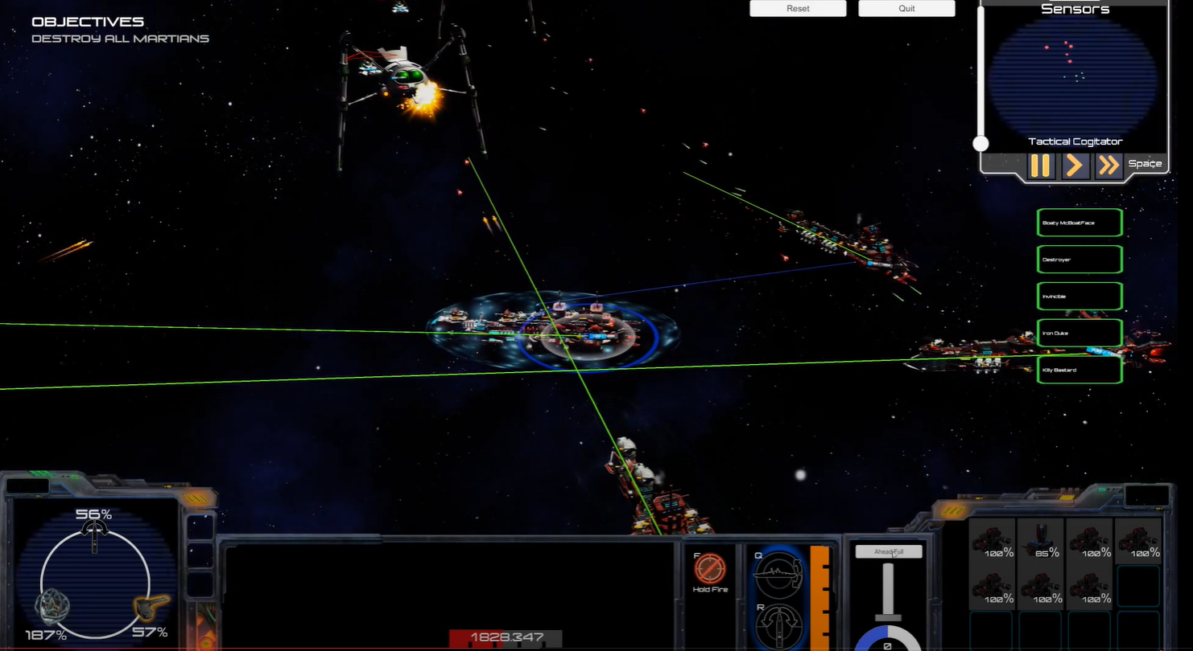
2 – 2: Rigidbody interpolation example
Conditional
Projectiles in Commodore Mandeville: Revenge of The Martians had to make use of interpolated rigidbodies.
Strategy game featured the ability to slow down time while issuing orders.
Game simulation would run at a different update rate to physics update rate, leading to choppy moving projectiles and ships during ramming actions.
Rigidbody interpolation updates the perceived transform of the object independent of the physics engine between physics updates each frame.

Slide 55
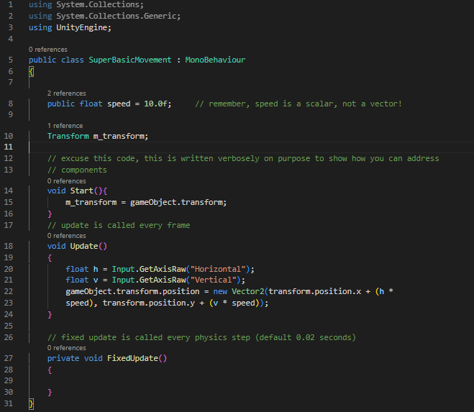
2 – 3: Scripting
Essential
You may attach scripts to GameObjects if they are of the type Monobehaviour.
As examples, you may be looking to implement movement mechanics, weapons, or bot AI.
Let’s have a look at a very basic 2D movement script:

Slide 56
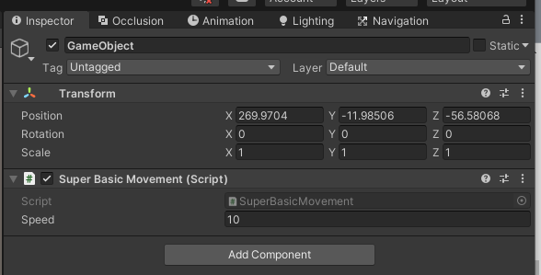
2 – 3: Scripting
Essential
We can see the representation of the Monobehaviour component we made in the inspector, after it has been attached to an empty GameObject.
SuperBasicMovement inherits from Monobehaviour.

Slide 57
2 – 3: Scripting
Essential
In the inspector, the public attribute speed can be seen. This lets us edit the default value of the variable in-editor without changing the code.
A Monobehaviour may reference its host GameObject by simply stating ‘gameObject’.
The transform of a GameObject can be referenced by simply stating ‘transform’.

Slide 58
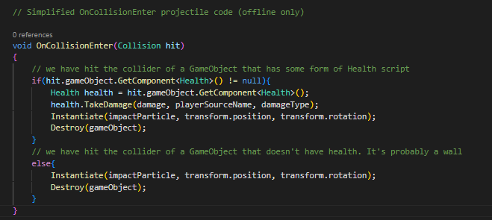
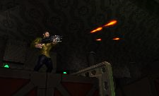
2 – 3: Scripting – Multiple Scripts
Essential
It is possible to call methods on other script components, so long as the methods are declared as public.
In this example, we look at a simple potential implementation of a projectile hitting a collider and dealing damage if it has an attached Health script.
projectile

Slide 59
2 – 4: Prefabs
Unity’s Prefab system allows you to create, configure, and store a GameObject complete with all its components, property values, and child GameObjects as a reusable Asset.
Any edits that you make to a Prefab Asset are automatically reflected in the instances of that Prefab, allowing you to easily make broad changes across your whole Project without having to repeatedly make the same edit to every copy of the Asset.

Slide 60
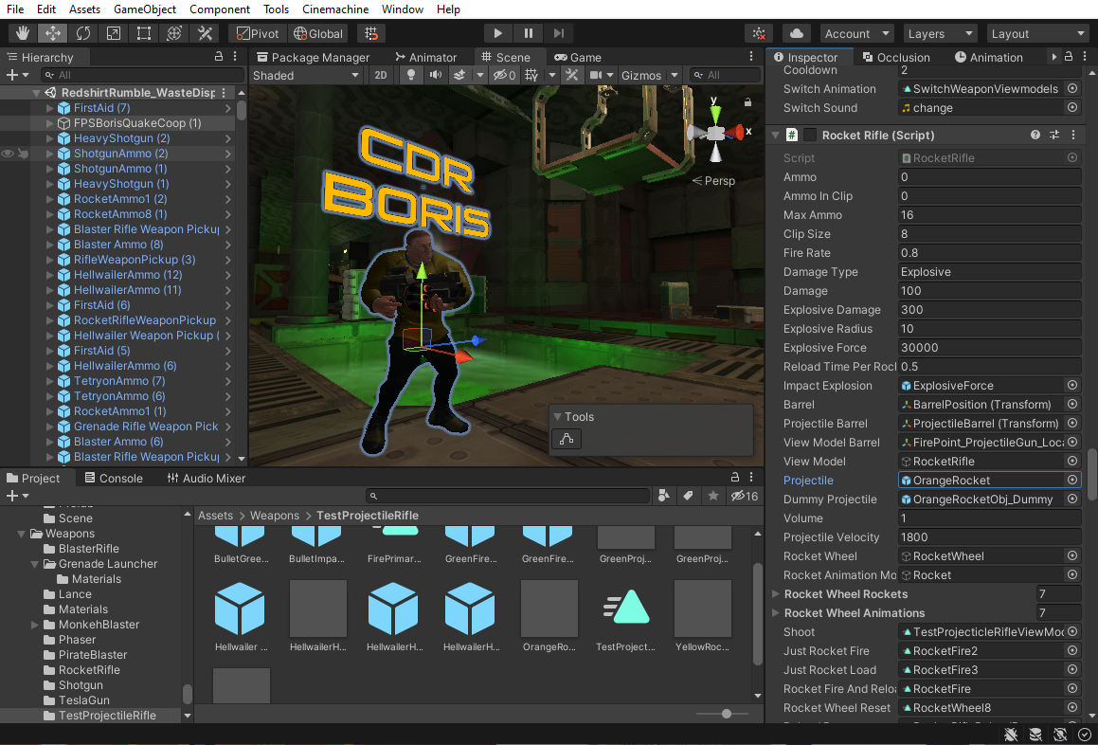
2 – 4: Prefabs
Continuing with our example, projectiles fired at runtime would be GameObject instances of a Prefab.
Boris may fire orange coloured rockets using his rocket rifle.
The Monobehaviour ‘Rocket Rifle’ has a public GameObject field ‘Projectile’. This may take a rocket Prefab object that has already been defined and saved to the project directory.

Slide 61
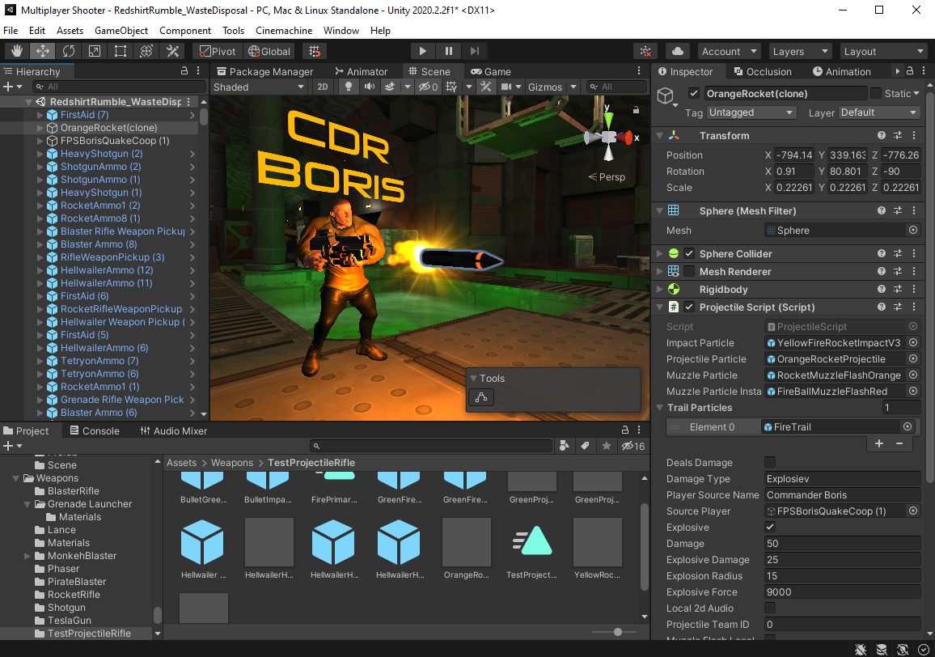
2 – 4: Instances
When Boris fires his Rocket Rifle, an ‘OrangeRocket’ GameObject is instantiated at the weapon’s barrel position.
The rocket’s properties have been defined by its original prefab.
The rocket has been named as a clone, as seen in the Hierarchy – a convention to denote GameObjects instantiated at runtime.

Slide 62
2 – 4: Instantiation
Show how the projectile was intantiated

